Slide 1
“Active Inference as a Framework for Social Science Agent-Based Modeling”
Featuring “Biofirm” Updates – Design Principles, Development
Applied Active Inference Symposium ~ 14 November, 2024
Andrew B. Pashea – Data Analyst / Scientist / Engineer
andrewbpashea@gmail.com || https://www.linkedin.com/in/andrewbpashea/
Resources:
Active Inference Institute – DeSci Learning, Sharing, Collaborating: Get Involved!
First Principles First – Bridging Conversations about Intelligence and the Future
My Github landing page for accumulating learning resources – https://github.com/apashea/IC2S2-Active-Inference-Tutorial
Slides + single- and multi-agent code for IC2S2 Active Inference workshop I delivered 17th July 2024 (3.5~ hours, 70+ slides of material)
Slides for this Symposium + Biofirm
Additional learning resources (e.g., Markdown-annotated script for working with agent belief matrices, YouTube livestream on constructing POMDP agents with pymdp library from scratch)

Slide 2
Outline
What is Agent-Based Modeling?
Micro-assumptions about Behavior: Utility-Maximization to Uncertainty Minimization, Homeostasis/Allostasis
Active Inference, POMDP as exemplar, Multi-Agent examples
Are LLMs agents?
Limits: context window, confabulation, impermanent short-term and immutable long-term memory
Augmenting agents with the capacity for capacity for LLMs: Long-term Memory, Knowledge Graphs, Designs / Schematics
Biofirm Development (Active Inference Institute + First Principles First)
Applying Active Inference: Vision for the future, Homeostatic Agents, Generating Artificial Environments

Slide 3
What is Agent-Based Modeling?
Agent – receive observations and return actions (example: an investor)
Environment – artificial (or real!) systems who elicit observations for agents and receive agent actions which impact the environment in turn (example: a stock market)
Reciprocal relationship: An agent’s/environment’s action is an environment’s/agent’s observation (ex. agent responds to a price signal by purchasing, reflected in morning prices)
In Active Inference, the agent and environment’s respective Markov blankets are statistically independent from one another – the sensory/observation and action layers vicariously connect them
Simulations – playing out the agent-environment dynamics over time (ex. in timesteps 1, 2,..)
Active Inference – action-perception loop
Core guidelines – balanced micro-assumptions (realistic yet simple-as-possible agents and environments), robustness (small changes do not dramatically change results), reproducibility (document and publish code), usefulness (why compute?) (c.f. Lazer & Friedman, 2007).
Purpose – predicting outcomes, e.g., extrapolating from the present, entertaining/testing counterfactuals (hypothetical scenarios), designing new policies, analyzing collective outcomes of aggregated individual behaviors
Cognitive turn – agents who deal with uncertainty and exhibit more realism (“autonomy”, biomimicry, cognitive mechanisms, learning, neuroscience-driven architectures); agents who have interpretable beliefs thus allowing analysis not just at collective but also at individual level (i.e. how will a policy impact the agents themselves?)
Reinforcement learning – attempts to bridge cognitive theory and autonomous decision-making and learning (rather than “traditional” hard-coded rules of ABM, e.g., “if X then do Y else do Z”)

Slide 4
Micro-assumptions about Behavior and Decision-Making
- Homo economicus and utility-maximization: what is utility?
- The neoclassical tradition tends to paint humans as utility-maximizers – often criticized for simplicity and claims of “greed”/immorality; Lionel Robbins: unlimited wants and scarce resources as fundamental economic problem
- Yet this assumption has itself been useful in the past – for agent-based modeling, it is incredibly computationally inexpensive to craft agents who act to maximize a single value. We then must make (and program) a singular assumption about the environment, e.g, utility (money, liquidity).
- Behavioral Economics/Finance, Psychology and Cognitive Science, Social Theory:
- Speculative, Fast & Slow, Heuristics/Habits (John Maynard Keynes, Hyman P. Minsky, Robert J. Shiller and many others on financial market speculation untethered from a “real” economy, infinite regress “I think you think that…”, “narrative economics”, info asymmetry; Kahneman’s Thinking Fast & Slow; Thaler & Sunstein’s Nudge)
- Social Emulation, Mimesis, Convergence, Ideology (Thorstein Veblen’s Theory of the Leisure Class on conspicuously signalling “status” as an end; André Orléan & Michel Aglietta on “money” / currency as at once a means of exchange, store of value, and social institution upon which individuals converge to gain access to commodities and social belonging; Louis Althusser on state/law & ideological/physical coercion to be a producer/citizen/subject)
- Pragmatism, Embeddedness (John Dewey on forward-looking individuals, pragmatic/contextual ethics & revising beliefs in light of scientific discovery; Karl Polanyi on economic activity being embedded in society, trust)
- Neuroscience, Biology, Physics:
- Inherent minimization of uncertainty and update beliefs, e.g., predictive processing theories, Bayesian Brain Hypothesis, Hebbian/associative learning
- Homeostasis and Allostasis (planning for homeostasis), physiological/neurobiological need fulfillment; unconscious processes (blood/oxygen flow regulation), preventative actions, forward-looking decisions and inference, habits for need fulfillment while minimizing expenditure
- Cybernetics, Embedded cognition, behavior & intelligence arising from interactions between brain, body, environment (not outside-in), mortal computation
- Collaboration and imitation, mirror neurons, intergenerational teaching and emulation
- Computational neuroscience/psychiatry/modelling, of internal dynamics (e.g., time-series, causal inference, neuroimaging spectral analyses correlated with behaviors, reinforcement learning & agent modelling)
- Hamiltonian Principle of Least Action – figuratively, what is the “easiest” path from one state to another
-

Slide 5
Micro-assumptions about Behavior and Decision-Making
Homo economicus revised?
Liquidity as means for all commodities – food, necessities for homeostasis/allostasis, physiological relief – (at least in a market economy, fungibility of things, etc.)
Even then – social/familial/kinship needs, physical health, all highly contextual to the individual; all perhaps more available yet not guaranteed as held liquidity accumulates
Shift: A virtually/contextually universal “value” computed by the brain, which can encompass not just a drive to liquidity but other aspects and means of life – simple as possible yet no simpler – becomes a simplified, recordable metric for measuring one’s capacity for current and future survival
- Free Energy Principle (FEP): minimizing quantifiable uncertainty, achieving goals, fulfilling needs, learning, updating beliefs – variational/approximate computation keeping metabolic (and for ABM, computational) costs low
Despite much higher global bodily energy expenditure/intake, the brain itself only consumes on average roughly four bananas’ worth of calories daily despite making 10^15 calculations per second (Kappel & Hamburg on Neuromorphic Computing, AII, 2023)
- FEP and behavior (policy inference): incorporating deliberative planning/goal-attainment/information-seeking conditioned on homeostatic preferences (G), confidence about that planning (γ), balancing complexity and accuracy in the situational context regardless of preferences (F), and habits/heuristics reinforced over time regardless of context or preferences (E)
Notes:
The point is that the free energy principle touches on many of these major theories and ideas about human behavior – homeostasis and need fulfillment, allostasis and planning, emulative and speculative beliefs, uncertainty reduction, habits and heuristics, computational modelling, neurobiological and empirical underpinnings and substrates for its theories, theoretical physics and the principle of least action. This is the framework I’ve proposed for ABM in the social sciences, where free energy metrics become an interpretable, multi-faceted yet singular values for understanding agent behavior and linking it with how we can use this for our ABM design considerations.

Slide 6
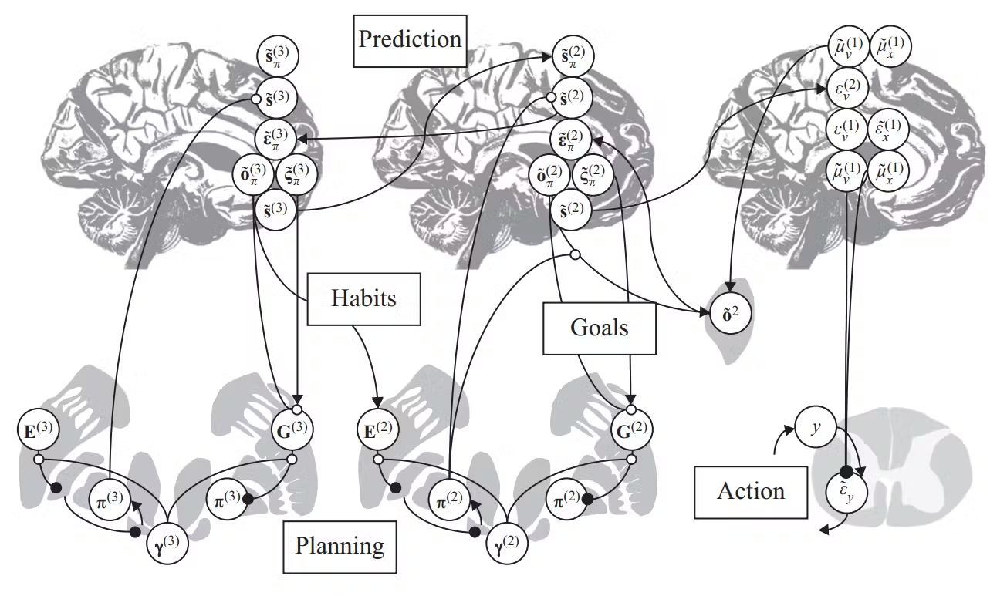
Anatomy of Inference: Mapping Interpretable Cognitive Mechanisms to Mathematical/Physiological Substrates
Active Inference theorizes the relationships between neurobiological and computational architectures
Model variables/parameters map to various cognitive processes
Free energy / prediction error minimization is carried out via message passing schemes on factor graphs
This tutorial will focus on discrete-time POMDP models, but message passing schemes for free energy minimization can in principle be applied to any probabilistic factor graph model
(Friston et. al, 2022)
—
Notes:
This is what I argued during my previous tutorial at the International Conference for Computational Social Science in July of this year.

Slide 7
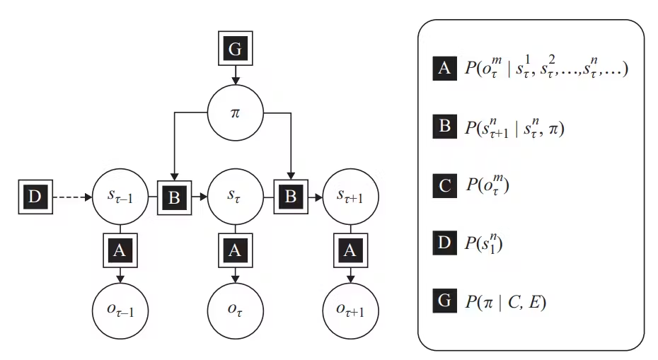
Modeling Inference: Variables in an Active Inference POMDP
POMDP Agent
- Figure 7.3,
Friston et. al
2022 Textbook
POMDP (partially-observable Markov decision-making processes) are the exemplar discrete-time models used in Active Inference, which entails the following key variables and characteristics:
- As before:
observations - “o”
states - “s”
priors - “D”
likelihoods - “A”
- Action
- habits - “E” (priors over policies)
- “policies” (sequences of actions; hypotheses about how to minimize free energy) - “pi”
- Preferences - “C” (priors over observations)
- Transitions of hidden states - “B”
- conditioned on actions/“policies” (pi), the temporal dimension of the model
—

Slide 8
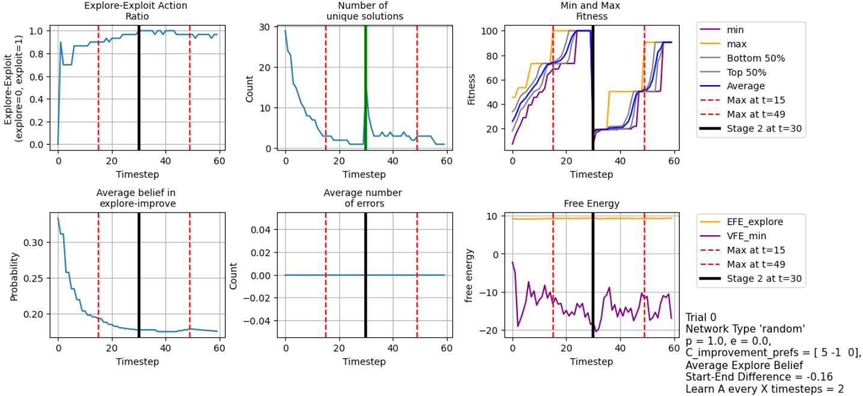
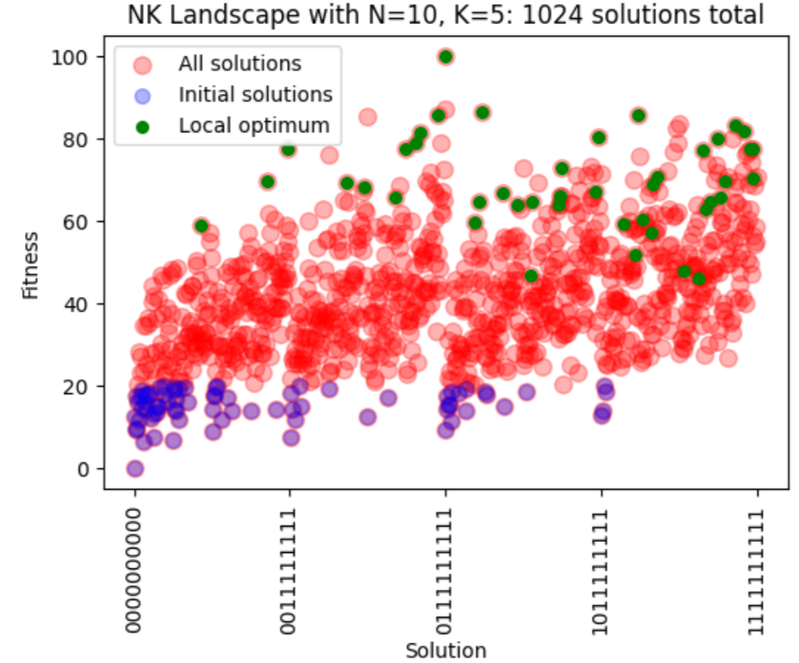
Multi-Agent Simulations with Active Inference
“Epistemic Communities under Active Inference” (Albarracin et. al, 2022)
belief sharing in networks of agents; self-evidencing and opinion dynamics; polarization of opinion
“Active Inferants: An Active Inference Framework for Ant Colony Behavior” (Friedman et. al, 2021)
stigmergic model; leaving pheromones to food source; adapt to changing context (food locations)
“As One and Many: Relating Individual and Emergent Group-Level Generative Models in Active Inference” (Heins et. al, 2024).
Cases where collective behavior approximates individual parameters
Interactive inference: a multi-agent model of cooperative joint actions” (Pezzulo et. al, 2023).
leader/follower joint action; synchronization of distinct roles
Active Inference Framework for Collective Parallel Problem-Solving on NK Landscapes (IC2S2 Active Inference Tutorial--Code/Slides) (Pashea, 2024))
Agents simulated in networks, where network topology (size, connectedness) impacts agents’ performance (ex. research team dynamics) on traversing fitness landscape in explore-exploit framework (recreation of “The Network Structure of Exploration & Exploitation, Lazer & Friedman, 2007)
A multi-agent system for integrated scheduling and maintenance planning of the flexible job shop (Pal et. al, 2023)
Multi-agent applications for job scheduling problems in industry applications and collaboration/synchronization, e.g., manufacturing
note: not ActInf; uses RL framework – point being to further dialogue between ActInf and other fields (e.g., RL)
(Pashea, 2024)

Slide 9
ABM & Natural Language Data: LLMs as “Agents”?
Integration of LLMs into a wide array of potential use-cases
Resources:
"Large language models empowered agent-based modeling and simulation: a survey and perspectives" (Gao et. al, 2023)
Repository of survey's paper sources (categorized)
Progress in LLM development increasingly exhibits more sophisticated reasoning capacities for these models with higher context & output windows, presenting a new means of leveraging everyday text files (documents, PDFs) for applications – why not forgo building agents (RL, Active Inference) and simply use LLMs themselves as agents via locally stored or API prompted LLMs?
Biases: LLMs are trained on large corpuses of existing text, sedimenting a series of cultural, scientific, explanatory/rhetorical, and prejudiced information – figuratively, a snapshot of the retrievable/scrape-able internet and/or other digitized human- and AI-produced texts – to which are trained internal parameters (black box, now numbering in the billions) and, consequently, the external outputs of these models
Many prejudices have been (and are still being) addressed as LLMs continue to be developed with methods like reinforcement learning with human feedback, i.e. providing reward signals to these LLMs during the training process to direct how LLMs respond to information and mitigate risk of harmful content.
That said, in practice users prompt LLMs, post-training, with a purpose or goal in mind that the LLM does not hold for itself. Humans must provide the context for this purpose or goal in their prompts, in the hope that the LLM will “catch on” – less figuratively, that the LLM will be able to predict the series of words and sentences which correspond (in the user’s final opinion) to the answer the user needs.
Post-training, the LLM cannot learn what the user needs, only infer the (series of words composing the) response in each instance of prompting, thus the significance of prompts.
All information submitted to an LLM in any given prompt/query composes the LLM’s “context window”

Slide 10
LLMs and Short-Term / Long-Term Memory
Hello, my name is Andrew.
LLM: “Hello Andrew. How can I help you today?”
Help me prepare an initial draft for a pro forma business model, with the following details: …
LLM: “Certainly. Here is an outline for an initial business model based on your specifications”
Output: Text File
Deleted conversation history or context window exceeded = context loss
Help me revise the file in the following ways…
LLM: “Please provide the file you mentioned.”
What is my name?
LLM: “Your name is ‘me’.”

Slide 11
LLMs and Short-Term / Long-Term Memory
- Recent “agentic” frameworks and workflows abound in recent research, yet the issues presented by limited context windows, confabulation (hallucination, i.e. structurally seemingly true information)
- LLMs with conversational histories (i.e. repeatedly re-prompting with recent conversation and important information – “reminding” the LLM of the context) have been considered to be “agents” in various cases
- Some general approaches to overcoming this include:
—Actor-critic frameworks: “2(+) minds are better than one”
2+ agents are given different role prompts and temperature (randomness) settings so that a more precise agent can “correct”/critique the responses of the other agent
—Building out databases of retrieved documents, e.g., domain knowledge, as the “ground truth” to be included/indexed in prompts and responses
—Thinking-reflecting frameworks, where LLMs must correct/revise their own responses (notice similarity to actor-critic)
Hello, my name is Andrew.
LLM: “Hello Andrew. How can I help you today?”
Help me prepare an initial draft for a pro forma business model, with the following details: …
LLM: “Certainly. Here is an outline for an initial business model based on your specifications”
Output Text File
Deleted conversation history or context window exceeded = context loss
Help me revise the file in the following ways…
LLM: “Please provide the file you mentioned.”
What is my name?
LLM: “You have not stated your name.”
- In all cases, the prompts are the guiding inputs for determining LLM outputs – they (ideally) provide the user’s context, preferences/intentions, and current state of knowledge to the prompt, while knowing that the LLM does not “learn” any of this information – it simply responds to the prompt / context window. For ongoing goals, we need dynamic means of storing and using this dynamic information. LLMs themselves are not “agents”, in this sense.

Slide 12
What’s in a prompt? – Integrating pre-structured prompts in software applications
- As researchers are increasingly aware, well-structured prompts which provide context and instruction to the LLM are crucial.
- “Prompt engineering” arose as a field (or, “art”) in and of itself, with now dozens of techniques, e.g., variations of chain-of-thought and sequential prompting, thinking-reflecting designs, in-training reinforcement learning with human feedback.
- “A Systematic Survey of Prompt Engineering in Large Language Models: Techniques and Applications”, Sahoo et. al, 2024.
- Repeated instances of problems with handling numerical or symbolic problems: intuitively, “2+2=4” as a string (natural language) may or may not be tokenized to be properly read as intended, i.e. as two numerical values to be combined via an addition rule to compute a further value. LLMs are getting better at this, but still risk imprecision.
- In a programming/software environment, mathematical or symbolic logic can be addressed outside of LLM logic via pre-structured prompts. For example, mathematical or clear rules-based computations can be carried out in Python code while the LLM handles the natural language aspects.
- Pre-structuring prompts with “empty spaces” allows integrating code and LLM prompts (e.g., using f-string literals to input local variables storing text, or agent beliefs, or existing retrieved domain knowledge into prompts automatically to provide concise, pre-structured yet repeatedly updated situational context + instructions for precise outputs).
- For RL/ActInf, one example: just as an agent can be equipped with discrete actions, e.g., “move left”, an agent can be equipped with discrete prompts as actions, e.g., action 1 = ask LLM for a solution to a {problem} given {current beliefs and observations}, action 2 = ask LLM to revise held solution to problem

Slide 13
Grounding LLMs: Augmenting agents with natural language
- In Active Inference, agents perceive (change their minds) and act (change the world) to realize their preferences in reality, e.g., maintaining homeostasis, planning for homeostasis (allostasis). Agents also engage in learning (updating internal model parameters relatable to synaptic learning/modulation, i.e. beliefs about state-observation relationships, efficacy of actions to impact/transition the current state, increased or decreased precision in beliefs).
- LLMs can be likened to agents who cannot act nor learn – only observe and infer. They are typically trained once (a very expensive process). Some advances have been made to train specialized LLMs, e.g., on texts for medical, legal, financial, or biomaterial research and use-cases, but again typically single training instances without online learning nor “preferences.”
- From a neurobiological perspective, LLMs have a very broad yet immutable long-term memory (trained once on many, many texts) and highly variable short-term memory (context window). They exhibit strong capacity for textual understanding and reasoning, but must (repeatedly) be provided context. Confabulation also a risk.
- Goal: Instead of thinking of LLMs as “agents”, consider LLMs as a language processing tool. From this vantage point, we can envision augmenting agents who learn and act (i.e. Active Inference agents) with the capacity for natural language.
“Understanding, Explanation, and Active Inference” (Parr et. al, 2021).
“Predictive Minds: LLMs As Atypical Active Inference Agents” (Kulveit et. al, 2023).
“MemGPT: Towards LLMs as Operating Systems” (Packer et. al, 2023).
“Neurophysiology of Remembering” (Buzsaki et. al, 2022).
“Designing explainable artificial intelligence with active inference: A framework for transparent introspection and decision-making” (Albarracin et. al, 2024).
Notes:
https://arxiv.org/abs/2310.08560

Slide 14
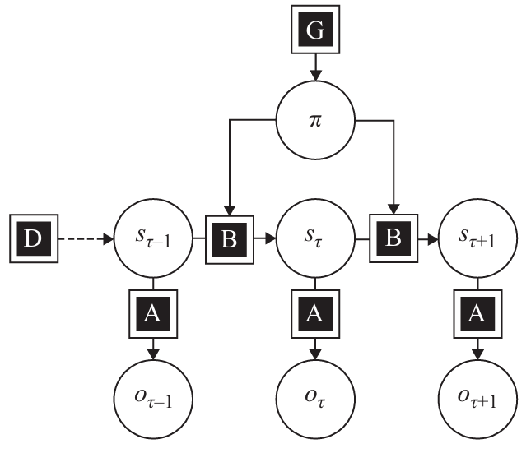
Grounding LLMs:
Augmenting agents
with natural language
POMDP Agent
- Figure 7.3,
Friston et. al
2022 Textbook
Expected Free Energy (including Preferences)
Policies
(Actions)
Temporal Belief Updating
(Priors to State Transitions)
- context from files, agent beliefs, knowledge can be incorporated into pre-constructed structured prompts for LLMs
Associations
(Likelihoods, P(o|s) )
Observations (Potentially Noisy)
- structured responses (requesting LLM to respond in particular ways) allows encoding for agent observations (discrete, binaries) and knowledge graph
STRUCTURED PROMPTS
LLM
STRUCTURED
RESPONSE
Documents
(PDFs, text)
“grounding truth”, preferences, goals
Knowledge Graph
stored context / “truth” / history
Notes:
POMDP: Figure 7.3, Friston et. al, Textbook, 2022
Discrete models, continuous models
Rather than having LLMs “lead the way”, we have our homeostatic agents augmented with the capacity for natural language. This is a kind of conceptual flip needed for combatting existential risk from LLM integrations. Here, just as a human has their own goals and ethical concerns, as does an agent. Just as a human prompts an LLM to find information while still requiring that the information be useful within different constraints – and be accurate and contextual for the problem-at-hand – so does an agent. LLMs can in certain ways be likened to a kind of dysfunctional static “perception” part of Active Inference: they take textual inputs and provide textual outputs, without learning in real-time as the immense amount of computational resources required to train LLMs renders online learning very expensive and often not worth considering. This is why we need agents whose preferences are aligned with humans’ preferences; whose survival is dependent on real-world factors like the health of their environment; and agents who can actually learn and adapt to various situations with online learning.

Slide 15
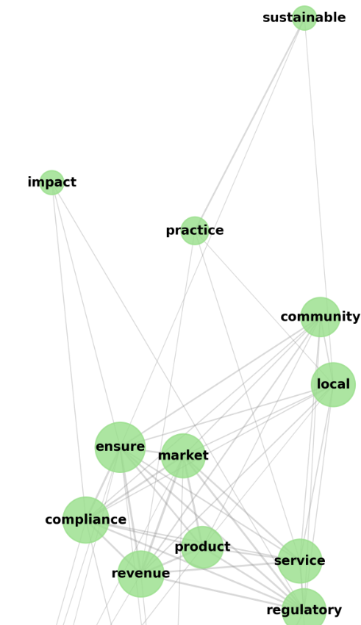
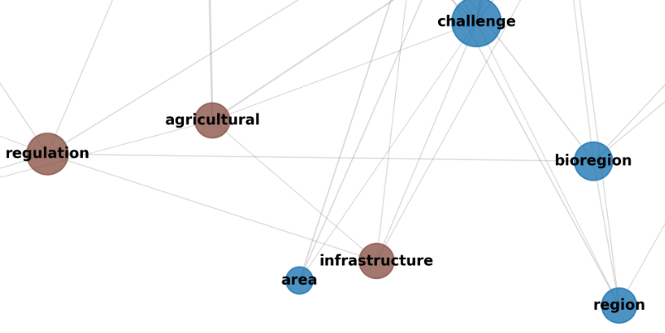
Knowledge Graph
See also Accelerating Scientific Discovery with Generative Knowledge Extraction, Graph-Based Representation, and Multimodal Intelligent Graph Reasoning (Buehler et. al, 2024), biomaterials use-case
- Accumulating contextual knowledge, guided by homeostatic goals
- Sources for updating knowledge may include user documents, up-to-date environment/resource reports and agent beliefs, domain knowledge, LLM responses to structured queries, business model as “shared narrative”, regulatory/legal compliance information, stakeholder statements
- Overcoming limited context windows:
– By using pre-structured prompts, we can “query” the knowledge graph in an initial step to find and extract relevant information for the situational context. This allows us to filter down to the needed information and synthesize it, reducing the final amount of information (tokens + LLM API costs) needed for the problem at hand.
- This conceptually can be likened to theories of episodic memory in the brain, e.g., the hippocampus as a “pointer” who sequentially retrieves contextual information as needed in real-time (Buzsaki et. al, 2022)
- Or, imagine querying a database (e.g., SQL, mongoDB) where a report is synthesized via joining and querying only the necessary tables/catalogs of logged information needed for the report.
Notes:
The notion of the knowledge base, or here “knowledge graph”, refers in part to the idea of a developing shared knowledge resource hub for the Biofirm. From a social sciences perspective, we might call this the development of a shared “cultural syntax” or “grammar” between our agents. In the case of the Biofirm, as agents strive to maintain their environment’s homeostasis – and plan for its future homeostasis, a.k.a. “allostasis” – which mirrors maintaining their own homeostasis and allostasis – the agents over time reduce their uncertainty both in terms of their moment-to-moment beliefs and internal model parameters while building up a natural-language-translatable knowledge base, or graph.
As is widely known in modern data science, natural language processing techniques are a powerful means of sorting, analyzing, and consolidating vast amounts of documents and text beyond what humans can do in terms of time, attention, and resources. Our current idea for implementation is heavily inspired by the work of Markus J. Buehler, for example his recent paper “SciAgents: Automating scientific discovery through multi-agent intelligent graph reasoning” where LLMs interact with a corpus of over 1,000 scientific documents to create novel ideas and methodologies for creating new biomaterials. However, in the context of that paper, an “agent” is equivalent to an LLM building a conversational history.
We wish to take this a step further: By having agents both build and utilize this graph, we can imagine a firm with a business model and knowledge database who can quickly onboard and train new employees as well as apply accumulated knowledge to problem-solving. By grounding the knowledge graph in agent operations, including the overarching goals agents have for maintaining homeostasis, sustainability, legal compliance and regulation, and other goal constraints, this knowledge graph is not some arbitrary collection of information – instead, it will be structured to align with agent goals and be updating over time to reflect this reality.

Slide 16
Agent Foraging & Knowledge Updating over time
Homeostatic Agents, Current Beliefs, Goals
What are causal determinants of soil structure in farms? Also, cite your sources used [and use API for source verification] and structure them in the following way…
LLM: “Soil structure in agricultural settings is determined by a complex interplay of natural and management-related factors. Natural determinants include physical processes like wetting-drying and freeze-thaw cycles, along with biological components such as root development, microbial activity, and earthworm presence. These work alongside chemical properties including soil pH, cation exchange capacity, and clay mineralogy. Management practices significantly influence soil structure, with beneficial actions like organic matter addition and proper crop selection promoting good structure, while destructive practices such as excessive tillage and soil compaction degrading it. The foundation of soil structure is also influenced by base conditions including the parent material, soil texture, topography, and time allowed for structural development. All these factors work in concert to create and maintain the soil's physical arrangement, which is crucial for agricultural productivity through its control of water movement, air flow, and nutrient availability to crops.”
[[Citations: {citation1}, {citation2}, {citation3}]]
[Follow-up queries]
Knowledge Graph
[Soil structure]
– determinants
– management
– conditions
– {citations}

Slide 17
Agent Foraging & Knowledge Updating over time
Homeostatic Agents & Current Beliefs, Goals
(extract and encode as agent observations for agent’s LLM-associated observation modalities; handle any additional encodings/computations as needed)
STRUCTURED PROMPT:
f“I believe the {environment_variables} are currently {agent_beliefs} but our goal is {business_model} and current constraints are {constraints}. What solutions exist to address this?”
LLM:
“Based on your stated goals, resources, and available policies and knowledge, here is an explanation of a policy to be taken and why…. [[ Explanation ]]
… and here is the structured encoding you requested denoted as follows:
A positive “1” approved recommendation to carry out available action “6”:
[[1]] [[6]]
Knowledge Graph
[environment_variables]
[business_model]
[constraints]
[domain_knowledge]

Slide 18
Biofirm Development & Testing
Biofirm code development is currently underway with AII President & Co-Founder Daniel Friedman & Institute member Andrew Pashea under guidance and partnership of John H. Clippinger and First Principles First (FP1.AI) in the Active Inference Institute’s central github codebase.
Github repository: https://github.com/ActiveInferenceInstitute/Biofirm
Tool highlights:
pymdp : Python library for constructing/running discrete time/space POMDP Active Inference agents
OpenAI API : API for choosing and prompting a wide array of SOTA LLMs
cursor : IDE (built on top of VS Code IDE) for editing and generating code via LLM prompting (codebase search)
Related Institute Projects: Existential Risk / Foresight, FLI Grant, FarmWorks, RxInfer Group, Economic Simulations subgroup
Recorded livestream updates – Major updates and Code walkthroughs (+ some classic comedy):
Active InferAnt Stream 006.1 ~ Towards (Open Source, Active Inference) Bioregional Biofirm Modeling
Active InferAnt Stream 007.1 ~ AgentMaker for PyMDP for Active Inference Biofirms for Bioregionalism
Notes:
Active InferAnt Stream 006.1 ~ Towards (Open Source, Active Inference) Bioregional Biofirm Modeling (48:10)

Slide 19
Biofirm
Agents working in a “firm” to maintain homeostasis of an environment, e.g., a farm, a natural land preserve.
Agents “prefer” (in a colloquial sense, as well as in a Bayesian priors sense) to (observe themselves) maintain their environment in homeostasis. Their own survival and health are directly linked with environmental survival and health, mapping internal states to inferred external states, conditioned on preferences. In Active Inference, an agent’s own homeostasis involves realizing its preferences, relatable to how humans infer and act to maintain their body temperature, oxygen and blood flow, sense of safety and security (physical, economic, etc.).
Minimizing uncertainty conditioned on preferences = minimizing uncertainty about if the agent is successfully keeping the environment in a homeostatic state.
Build a knowledge base, ex. a knowledge graph, via initial user-submitted documents, followed by structured prompting over time (and potentially local syllogistic reasoning-based rules extracted from text) all motivated by agent preferences and beliefs.
Social Science: agent collaboration (in coalitions, in networks), augmenting agents with ‘natural language’ + state belief reporting with consequent development of a cultural grammar / script(s) and shared narratives, economic resource management and value generation
Value generation: agents reduce expected free energy (approximate uncertainty, conditioned on preferences) where their marginal contributions to expected free energy minimization of the overall firm generate measurable value representative of uncertainty reduction. This accumulation is therefore not an arbitrary, floating value: moment-to-moment value generation reflects the agents’ learning and capacity for taking care of their environment.

Slide 20
Multi-agent Setting and Future Vision
- Cultural – An ever-evolving accumulation of shared knowledge whose evolution is motivated by, and mirrors, agents motivated to accomplish collective goals for homeostasis from various perspectives – a shared cultural grammar/syntax.
- Ethical – Accumulating different perspectives (between agents, between users/stakeholders in submitted documents, financial, regulatory, & sustainability knowledge) can allow for comparing and synthesizing various perspectives in an “actor-critic” framework to better ensure information is accurate and coherent as well as identify faulty or contentious information (e.g., an aggressive policy can be critiqued and revised from an ethical, regulatory, and/or legal standpoint).
- Collective – We can synthesize information in the knowledge graph to generate summary documents acting as “primary” documents for a collective of agents, e.g., a “business model”, a “constitution”, a set of protocols or missions, etc.
- In our “Biofirm”, a “business model” can be synthesized (and updated) to provide a more concise summary of the most important areas of knowledge. This includes long-term goals, recent short-term goals and progress updates, resource availability, evaluations of individual agents, reports and forecasts regarding the environment, and so on. The “business model” could then be updated over time and reviewed, say, by researchers and users in order to more quickly peruse recent Biofirm goals, plans, and operations.
- Sustainability and Resource Management – Awareness of available resources, combined with quantitative analysis (e.g., price information, forecasting supplies needed for a particular policy) and qualitative reasoning (which supplies are needed for a task, for what purposes, within what ethical/regulatory guidelines)
- Heterogeneity – Agents might be pre-configured (or learn, or “evolve”), to specialize in different skills and knowledge uses, allowing for agents to collaborate under broad shared goals while working on sub-tasks.
“Epistemic Communities under Active Inference” (Albarracin et. al, 2022).
“Modeling Sustainable Resource Management using Active Inference” (Albarracin et. al, 2024).
A multi-agent system for integrated scheduling and maintenance planning of the flexible job shop (Pal et. al, 2023).

Slide 21
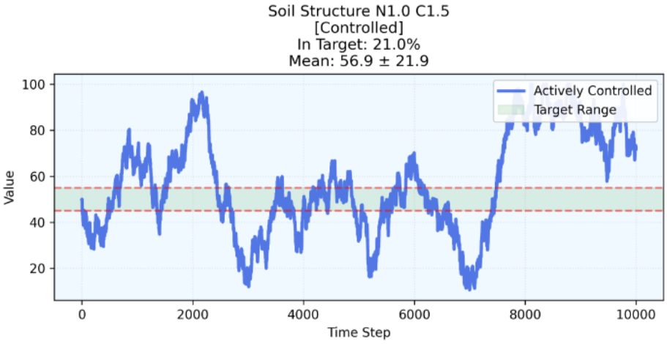
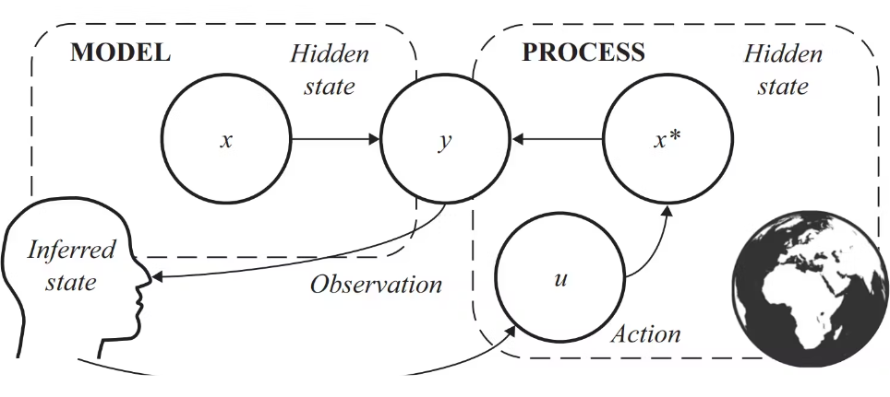
Basic form of a Homeostatic Agent
- A simple, initial form of the “homeostatic agent” involves a POMDP agent who is mapped to an environmental variable
- For example: a measure of soil structure (related to tillage, upkeep) on a farm.
- The agent’s preferences (“homeostats” for survival) are set to mirror those of the environment’s target homeostatic range.
- The agent strives to commit actions which brings its mapped variable into homeostatic range.
- Observations – Variable (in the data) is LOW, HOMEOSTATIC, HIGH
- Hidden States – Belief (about the data) LOW, HOMEOSTATIC, HIGH
- Actions – Agent can DECREASE, MAINTAIN, INCREASE the variable
- Preferences – HOMEOSTATIC
Figure 2.2 Friston et. al 2022 Textbook

Slide 22
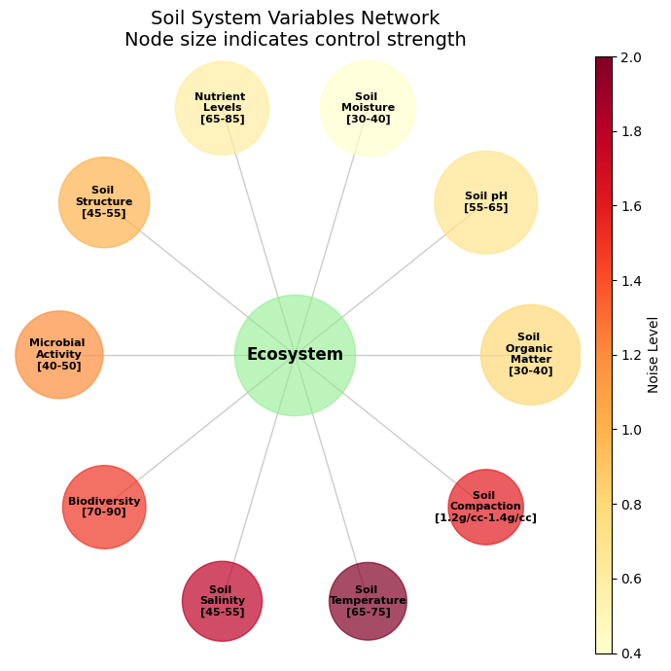
Homeostatic Agents Solving Nonequilibrium Steady State Systems: How do agents/environments persist?
A "non-equilibrium steady state" refers to a system where, despite being constantly out of thermal equilibrium due to external forces, the overall state of the system remains unchanging over time, meaning its properties do not fluctuate with time, even though there are continuous flows of energy or matter through it; essentially, it's a stable state that exists while actively exchanging energy with its surroundings, unlike a true equilibrium state where no net exchange occurs.
The system requires continued active maintenance through control inputs to keep variables in homeostatic ranges.
–These target ranges themselves might change
–ex. shift target soil temperature range for seasonal crop change; changes in environment structure
To maintain desired states, the agents must continuously work against natural tendencies of the system.
–States may have complex, interdependent relationships, calling for agents with forward-looking inference horizons
–ex. Over-maintenance of soil may harm local biodiversity, yet excessive pests harm crop growth.
–Crucially, in reality we might only be able to impact some variables and not others, thus agents may specialize in handling one particular controllable variable and study its relationship with the other variables, leading to actionable predictive planning.

Slide 23
Homeostatic Agents: Solving Nonequilibrium Steady State Systems – Ever-solving the Commons?
Local rules, conditions, adaptation:
Approaches to governing each variable are individualized based upon variables’ relationship with other (un)observed and (non)controllable variables as discovered in observed evidence (text and metrics)
Recognizing uncertainty and adaptation:
Resource/homeostasis management adaptive, via agent learning, to changing conditions in broader unobserved, uncontrollable environment (e.g., impact of climate change, natural disasters, other endogenous or exogenous shocks)
Governing the commons:
Reference to evolving, natural language-based and/or extracted syllogistic “cultural” rules for maintaining homeostasis, synthesizing and incorporating various perspectives from stakeholders and domains, repeatedly grounds agents in common goals for maintaining the environment against perturbation and capture, maintaining its Markov blanket
Nested collaboration:
Just as users can practice oversight, agents for oversight – agents above or below other layers of agents – may be constructed to maintain oversight and utilize/update knowledge graph to evaluate other agents’ policies.
Knowledge
Graph

Slide 24
Biofirm for Users
Submit documents and text, e.g., PDFs containing documentation, real-world information, instructions, forms; submit historical data or use evidence-based “text-inspired” data for testing (e.g., textbooks, research papers, formulae)
Two intended paths to generating agent-based models:
1. For exploring counterfactuals: generate synthetic data using domain knowledge and/or historical data
2. Direct application: submit your own collected streamed and/or historical data
Generate environment for our agents and construct applicable agents in AgentMaker
Simulate agent-based model, i.e. initialize initial setup phase then run action-perception loop
Data and LLM responses are encoded as observations for our agents
Agents take these observations to infer the homeostatic states of the environment. Agents equipped with policies – whether pre-defined or evolving over time – learn to apply these policies in a way that positively impacts their environment, as evidenced in the next round of data from the environment in the action-perception loop.
“Homeostasis” for the agent – their preferences, their figurative blood flow and oxygen levels and caloric intake, their survival – is hard-coded in their design
Analytics:
Derive insights from metrics recorded over time: agent actions taken, free energy minimization, belief accuracy, value generated, LLM-based summary reports and recommendations, contributions of individual agents and coalitions of agents, etc.

Slide 25
Bioregional Modelling: Starting with Documents
Structured Prompts to Research to Executive Summaries
Example link to repository: Business Case Executive Summary tailored to Hampshire, MA
Submitted structured queries/prompts to LLM to generate initial synthetic documents
Next: developing more sophisticated, integrated means for gathering, verifying, and synthesizing domain knowledge; references to current resources; computations within and without LLM utilization
Revisions to “business model” based on changing conditions, adaptation, evolution of niche construction, specialization(s)

Slide 26
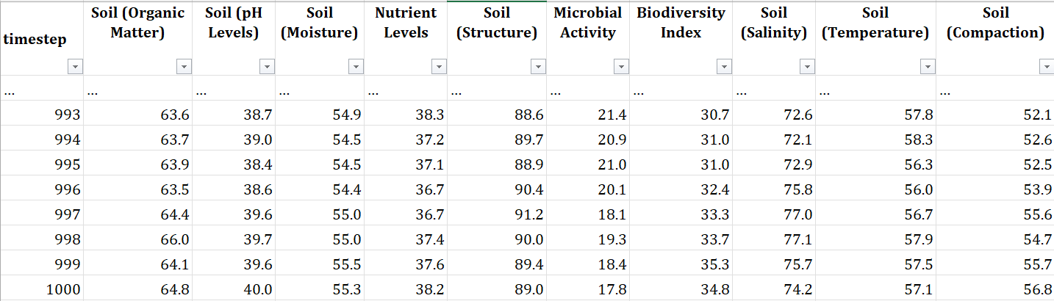
Biofirm Testing & Development: Generating Artificial Environments
STRUCTURED PROMPTS
LLM
STRUCTURED RESPONSE
Programming Environment
Dynamics & Configuration, generate descriptions, ecosystem_config.json
User documents
e.g., variables/proxies, domain-inspired quantitative relationships, distinct noise level and controllability per variable

Slide 27
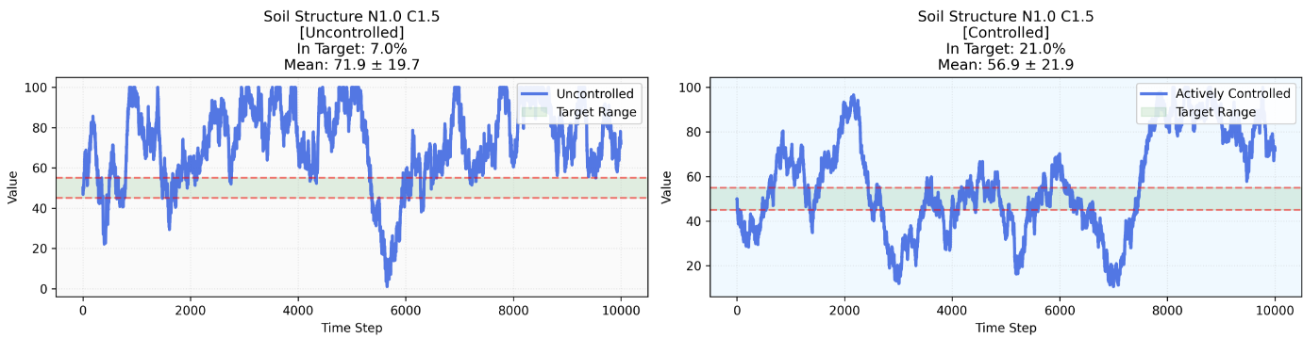
Biofirm Development & Performance Benchmarking
- Start simulation, environmental dynamics play out, compare agent performance
Reactive/Random Thermostat
– if [variable] below target, INCREASE
– if [variable] above target, DECREASE
– if [variable] in target, MAINTAIN
Active Inference Agent
– Actions: DECREASE, INCREASE, MAINTAIN
– Beliefs about environment, action efficacy, homeostatic preferences
– Capacity for sequential planning
– Can incorporate knowledge about
other variables and relationships
Notes:
In our simulations of an artificial environment, all variables begin in homeostasis. As we begin running the simulation, the variables quickly begin to change as they have complex relationships between one another, mirroring real-world data collected over time from IoT devices, environment inspections, financial or resource management records, and other sources.
As an additional step, we’ve developed simple Active Inference agents who control their own “part” of the environment, in comparison to a random control. This allows us to make benchmark comparisons between how our Active Inference agents compare to simpler, reactive agents.
The environment itself is composed of various variables which have complex relationships from timestep to timestep (i.e. data collected at an interval whether it be weekly, daily, or minute-to-minute). For example, soil structure might depend on

Slide 28
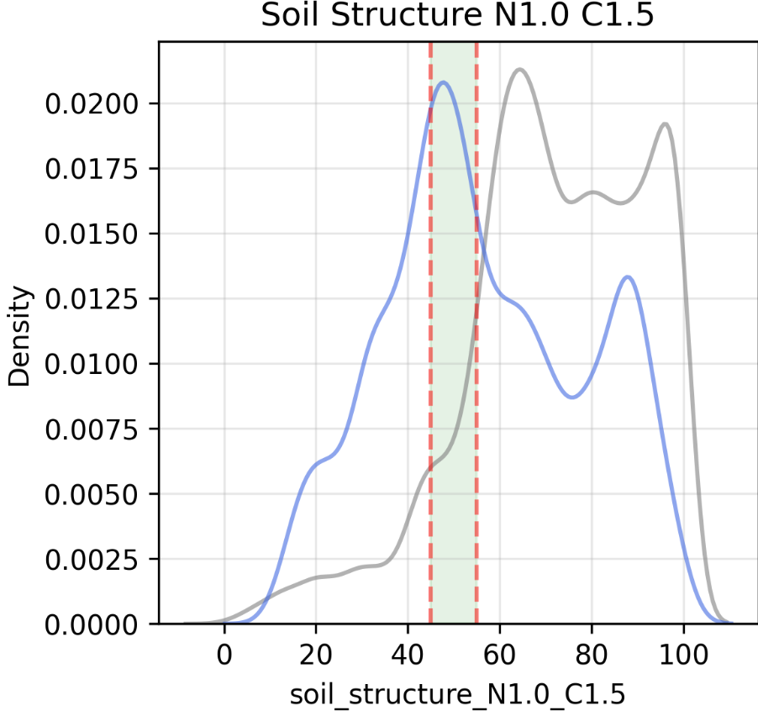
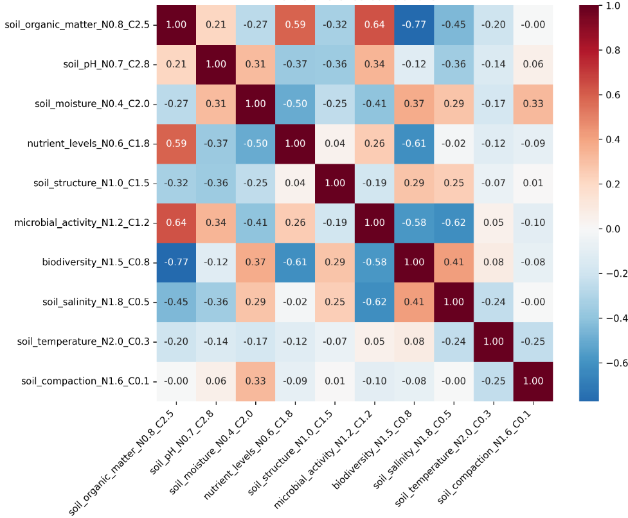
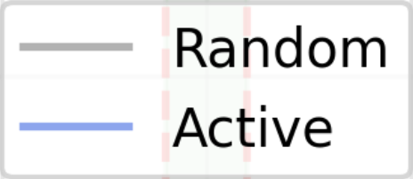
Analytics Suite: Agent comparisons & Environment Patterns
LLM: “Agents’ efforts to maintain soil structure (tilling) was frequently successful but had to be balanced to avoid negatively impacting organic matter, ….”
By tracking metrics about the environment, we can compare how the environment behaved in different simulation settings, e.g., with different agents, how environmental variables correlated with one another over time – and with further LLM integration, can translate findings into natural language for easier interpretability, providing further insights. The user could then in turn submit new documents as human feedback to be incorporated into the knowledge graph.

Slide 29
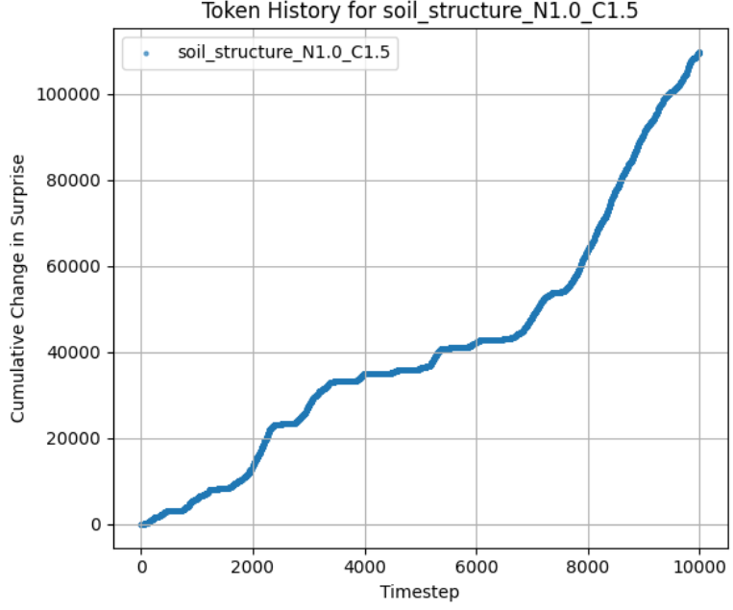
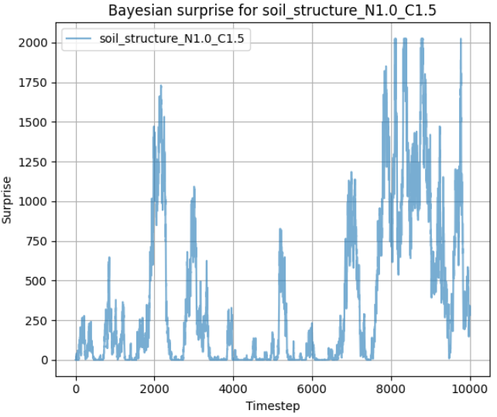
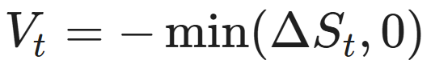
Module: Reduce Uncertainty / Generate Value
Uncertainty Metric “Surprise”
– Active Inference Agents minimize uncertainty to bring variable into target range; Bayesian surprise as more precise metric where tractable
– Bayesian surprise as KL divergence between prior and posterior distribution, further penalized when outside homeostatic range
–Other metrics, e.g., Expected Free Energy, State Accuracy
Uncertainty Reduction “Value Added”
–Initial conception:
–i.e. “value added at time t equals how much surprise was reduced, if and only if surprise was reduced”
–thus no value produced when surprise is not reduced, for NESS / complex environments where there is tendency towards increasing surprisal
–Modularized for Testing: user can maintain oversight,
experiment with rules
Notes:
As agents reduce their uncertainty about their environment, they are effectively generating value. In this version, we can quantitatively measure “uncertainty” as Bayesian surprise, aligning with the Active Inference framework. Here, Bayesian surprise is essentially a measure of how much the true data differs from our expectations of it–where here our expectations are that the data lie in the homeostatic range. It’s as if we can say, “I am only surprised when my environment is not in homeostasis – the further we are from homeostasis, the more I am surprised”. So, as agents manage their environment overtime to achieve homeostasis, we can track how much surprise is reduced. Reduction of surprise (or uncertainty) thus reflects two real metrics: agents’ learning and efforts, and the actual health of the environment, each of which we consider to be of value for the overall Biofirm. Value can thus accumulate in this way, where at each timestep reductions in surprisal multiplied by negative one are individual accruals of value.
As we know, environmental disturbances can happen – if we already perfectly knew how everything worked and will always work, we would never need to problem-solve. We can imagine a scenario where some disturbance, such as a natural disaster or drought, climate change impact, the preferences of stakeholders, or other disturbances generate surprise for the firm – in this case, resolving these disturbances in a way which aligns with firm goals will decrease surprise and therefore generate value.
Agents, as employees of the firm, can then be compensated for their

Slide 30
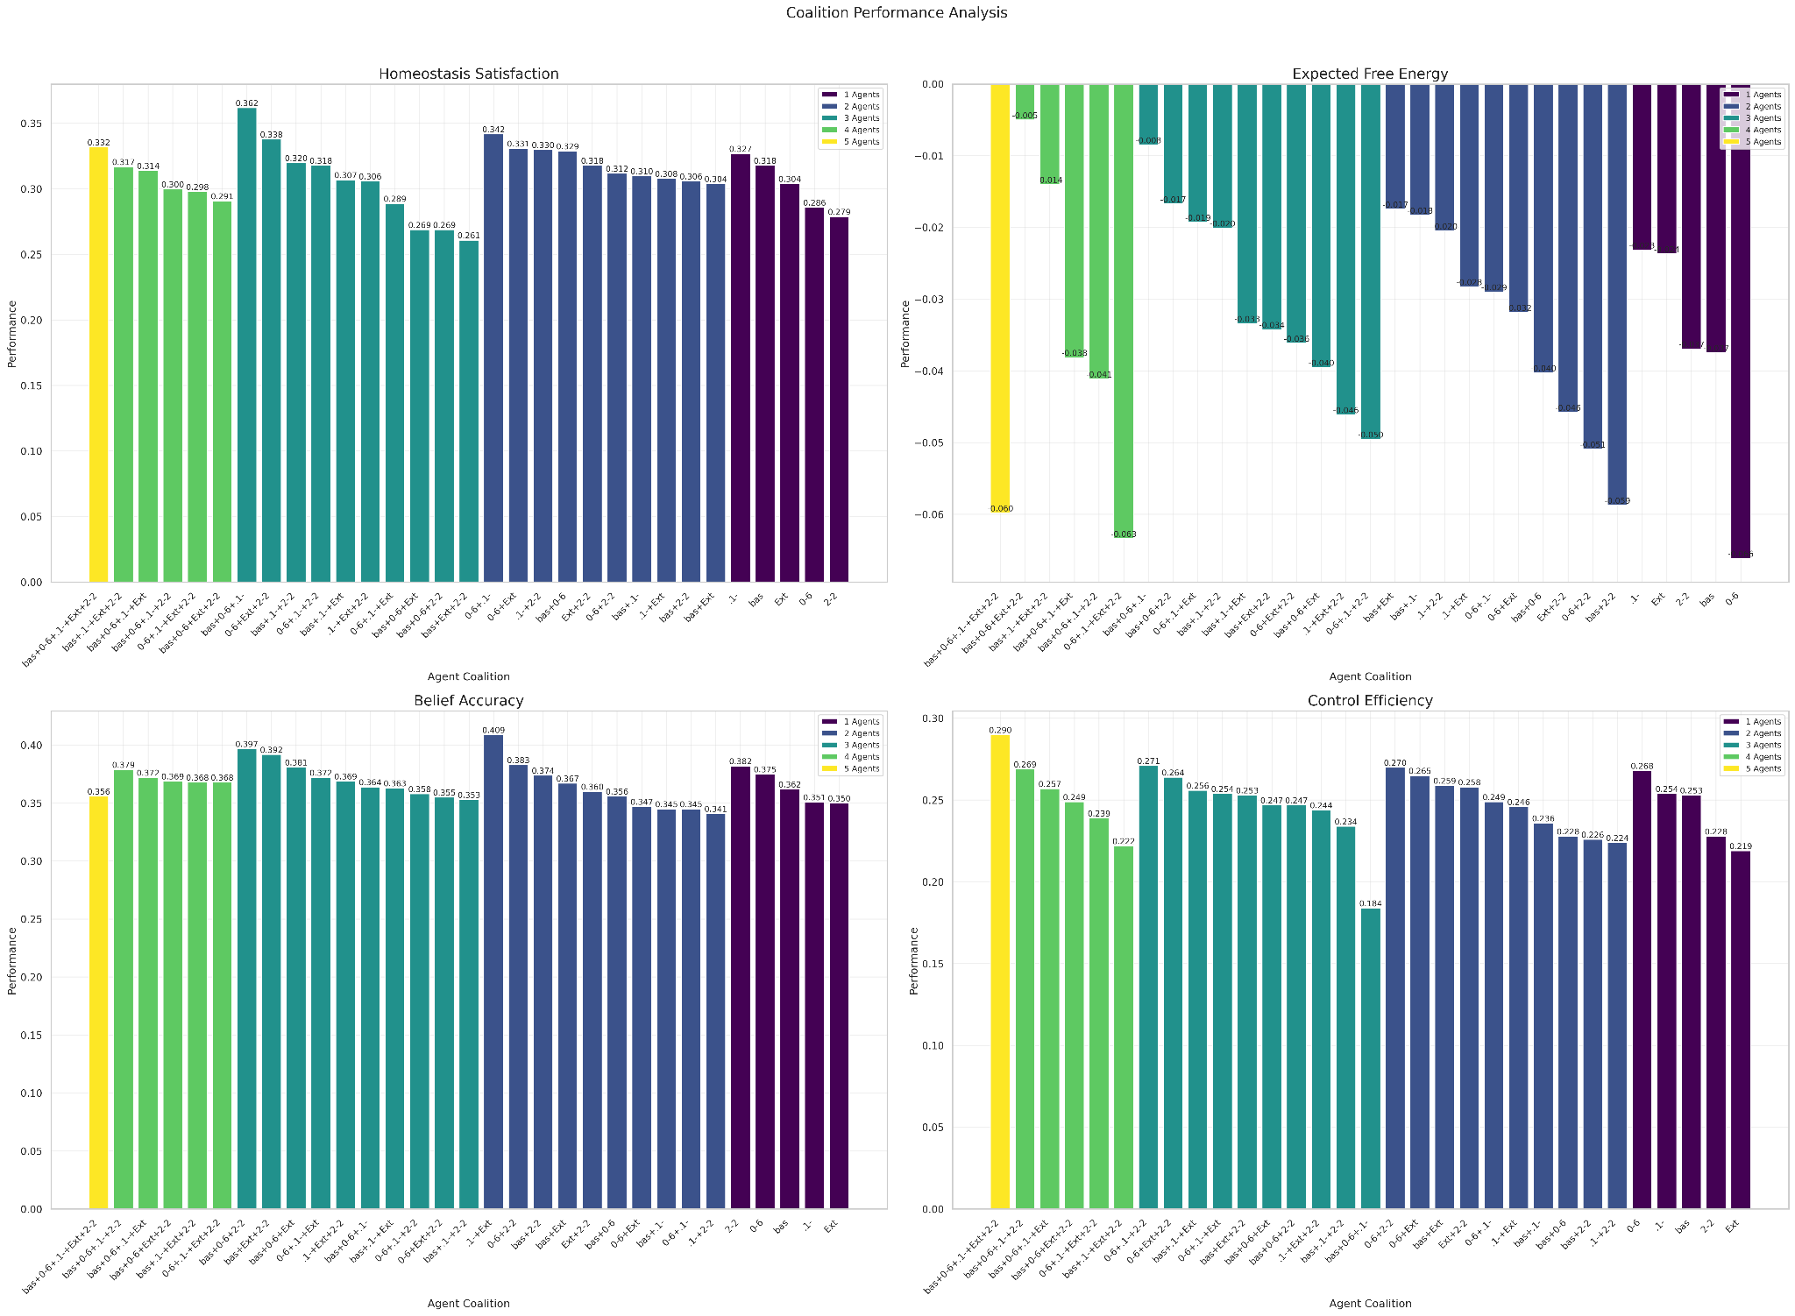
Analytics:
Agent coalitions
- Analyze the contributions of agents to homeostatic regulation/satisfaction, free energy reduction, belief accuracy of the firm over time
- Shapley values: we can analyze the contributions of different coalitions of agents
- e.g., agents who differ in preferences, likelihoods, …

Slide 31
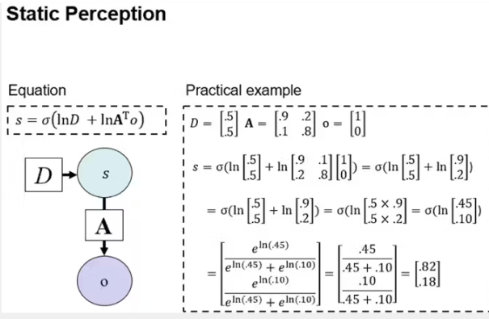
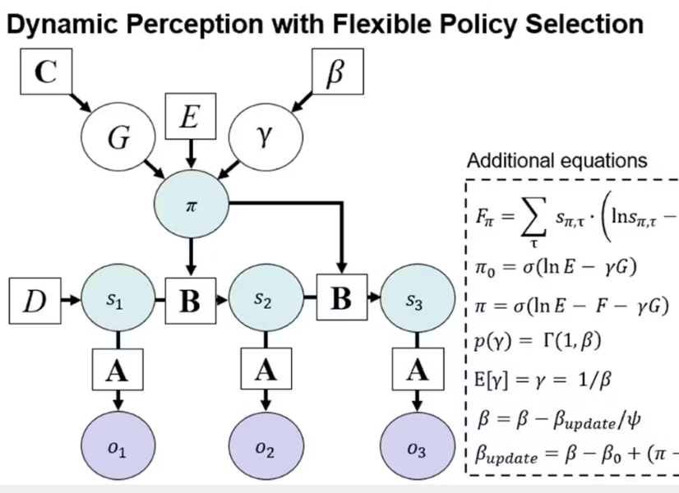
GNN & AgentMaker
- GNN (General Notation Notation) (Smékal & Friedman, 2023)
- Livestream on implementation:
- CODA website for resources & further development: https://coda.io/@active-inference-institute/generalized-notation-notation
- Standardized method for translating and building models,
e.g., Active Inference Agents
- “Triple Play” approach to constructing and “translating” agents:
define agents in natural language, suitable for dialogue with LLMs
define agents graphically, e.g., visualizing architecture
define agents as executable code, for application/implementation
i.e. multimodal, multilinguistic (programming languages) agent development, defining matrix dimensions (number of states factors, observation modalities, levels, preferences, etc.)
- AgentMaker Repository
Library built from fork for pymdp, the quintessential Python library for Active Inference POMDP modeling inspired by functionality of spm in MATLAB
Direction: construct and test customized agent in AgentMaker in the Biofirm in a “plug-and-play” way
Next steps: Agents who model entire environment (receive observations from all variables, infer hidden states of entire environment, i.e. “Watch the world, tend to your part”)
Notes:
https://www.perplexity.ai/search/summarize-the-attached-paper-uq7QXVCIRcOhRysv54n9CQ

Slide 32
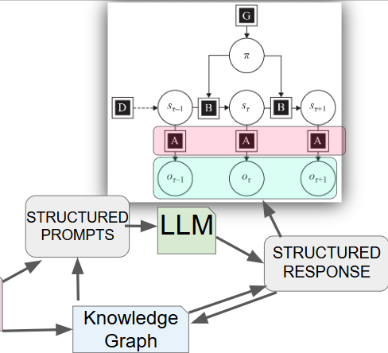
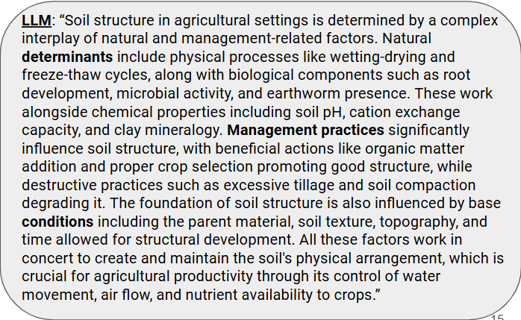
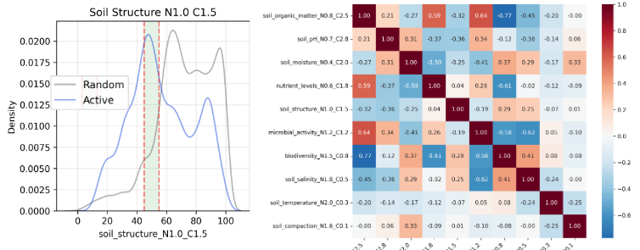
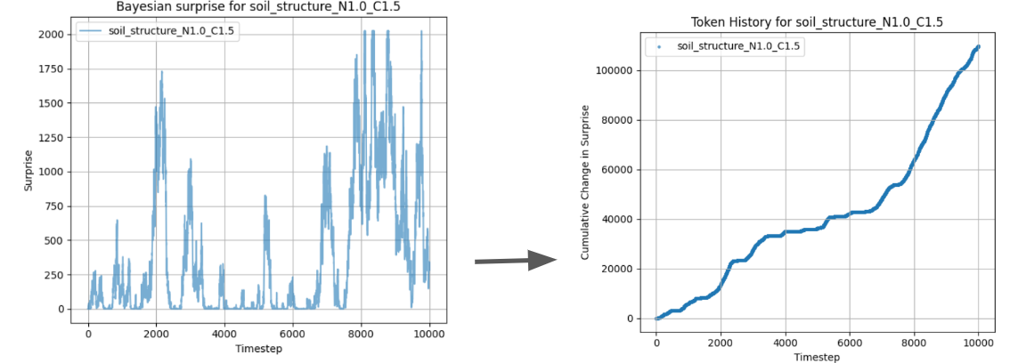
1. User inputs
2. Customization / Fitting
3. Simulation / Analysis / Interface / Dashboards
AgentMaker
- customize agents
- translatability
Data for fitting
Knowledge Graph/Base
Knowledge
Graph
Documents
(PDFs, text)
Ecosystem
- simulate via
fitting data and/or
domain reasoning
- homeostatic range
& config defined
Towards an adaptable
“kernel” Biofirm

Slide 33
Future Design Considerations & Implementations
Resource management:
Just as we can read real data (or generate artificial data) for farmland variables, we can do the same for financial and resource management data, e.g., “finance” and “supply chain” agents who further synchronize with the Biofirm just as do other agents.
Knowledge graph logics and agent-LLM integration logics: experimentation with algorithmic structured prompting design
“Hub” development:
Multiple Biofirms in communication with one another, information/knowledge sharing
Continuous state space predictions:
Various means of implementing high-precision values already exist, e.g., we can equip agents with SOTA machine learning models and forecasting tools, and/or continuous state space Active Inference agents who compute values internally (RxInfer).
Active Data Sampling – more selective “as needed” LLM prompting
Amortized Inference – accelerating inference via re-using previous computations for scaling
AgentMaker experimentation – “Watch the world, control your part” (agents who infer states over multiple variables); “Observer” agent for Principal-Agent problem / hierarchical layer; contextualize agent actions (e.g., using knowledge graph to define what “INCREASE” really means in the moment, modifying controllability impact based on other factors, …)
Value compensation mechanisms:
Ethical fairness and sustainability, including in terms of value generation, are essential to this project. Agents can be “paid” for their contributions to the firm based on the Shapley values computed from their contributions to reducing free energy (uncertainty, surprise).
RxInfer : julia library for discrete or continuous time/space Active Inference agents, reactive framework
RxEnvironments : julia library for reactive environments
Interface/GUI tools for bringing interactivity and dashboards to users
APIs/integrations based on use-case (weather APIs, Semantic Scholar/arxiv for paper search, economic and other domain database integration, local/cloud data storage considerations)
HuggingFace LLM models for local fine-tuned open-source LLM prompting

Slide 34
Biofirm Development & Testing
Biofirm code development is currently underway with AII President & Co-Founder Daniel Friedman & Institute member Andrew Pashea under guidance and partnership of John H. Clippinger and First Principles First (FP1.AI) in the Active Inference Institute’s central github codebase.
Github repository: https://github.com/ActiveInferenceInstitute/Biofirm
Tool highlights:
pymdp : Python library for constructing/running discrete time/space POMDP Active Inference agents
OpenAI API : API for choosing and prompting a wide array of SOTA LLMs
cursor : IDE (built on top of VS Code IDE) for editing and generating code via LLM prompting (codebase search)
Future possibilities:
RxInfer : julia library for discrete or continuous time/space ActInf agents, reactive framework
RxEnvironments : julia library for reactive environments
Interface/GUI tools for bringing interactivity and dashboards to users
APIs/integrations based on use-case (weather APIs, Semantic Scholar/arxiv for paper search, economic and other domain database integration, local/cloud data storage considerations)
HuggingFace LLM models for local fine-tuned open-source LLM prompting
Integration with work of other researchers/developers in Active Inference
Related Institute Projects: Existential Risk / Foresight, FLI Grant, FarmWorks, RxInfer Group, Economic Simulations subgroup
Recorded livestream updates – Major updates and Code walkthroughs (+ some classic comedy):
Active InferAnt Stream 006.1 ~ Towards (Open Source, Active Inference) Bioregional Biofirm Modeling
Active InferAnt Stream 007.1 ~ AgentMaker for PyMDP for Active Inference Biofirms for Bioregionalism
Notes:
Active InferAnt Stream 006.1 ~ Towards (Open Source, Active Inference) Bioregional Biofirm Modeling (48:10)

